Slide 1

Customer Behaviour & Business Performance Analysis for ABC Communications Ltd Telco Customer Churn Dataset
Prepared by Adesola Sobambo
Data Analytics Internship Program – AnalystLab Africa
August 8, 2026

Slide 2

Agenda
01 Business Problem & Objective
02 Dataset Overview
03 Key Insights
04 Business Risks
05 Business Opportunities
06 Recommendations
07 Conclusion

Slide 3
Business Problem & Objective
The Problem
26.5% of customers have churned — 1,869 out of 7,043.
That drop-off is eating into recurring revenue.
Business Objective
Understand why customers are leaving and which factors matter most, so the team can act before it's too late.
Why It Matters
Winning a new customer costs far more than keeping one.
Cutting churn protects revenue and grows customer lifetime value.

Slide 4
Dataset Overview
7,043
Total customers
21
Variables tracked
0
Missing values
0
Duplicate records
21 variables cover demographics, services, contract terms, payment methods, and charges — with Churn (Yes/No) as the target.
The data's clean and ready to go: no missing values, no duplicate records — a solid foundation for spotting what actually drives churn.

Slide 5
Contracts & Internet Service
1. Contract type is the strongest churn driver
Month-to-month: 42.7% churn
One-year: 11.3% churn
Two-year: just 2.8% churn
2. Fiber optic customers are a high-risk group
Fiber optic: 41.9% churn
DSL: 19.0% churn
No internet: 7.4% churn
Fiber customers churn at more than double the DSL rate.

Slide 6
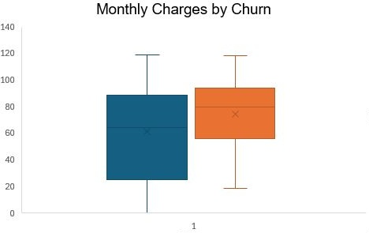
Payment, Tenure & Monthly Charges
3. Payment method matters a lot
Electronic check: 45.3% churn
Automatic payments (bank transfer / card): only 15–17%
4. New customers are the most likely to leave
0–12 months tenure: 47.4% churn
Churn drops off fast the longer someone stays.
5. Bigger bills, bigger risk
Churned customers pay ₦74.4 on average
Retained customers pay ₦61.3 on average

Slide 7
Business Risks
1
Too dependent on month-to-month plans
A large share of customers sit on the highest-churn contract type (42.7%), which keeps revenue unpredictable.
2
Fiber Optic is bleeding customers
At 41.9% churn, the profitability of this premium service is under real pressure.
3
New customers don't stick around
Nearly half (47.4%) leave within their first year, so acquisition spend isn't turning into long-term value.

Slide 8
Business Opportunities
1
Move customers onto longer contracts
Shifting people from month-to-month to one- or two-year plans could meaningfully cut churn.
2
Push automatic payments
Getting customers off electronic checks and onto bank transfer or card payments improves retention cheaply.
3
Invest in the first year
A stronger onboarding and early-engagement experience can catch at-risk customers before they leave.

Slide 9
Recommendations
1
Migrate month-to-month customers
Move them to one- or two-year contracts using targeted incentives.
2
Fix the Fiber Optic experience
Investigate what's driving dissatisfaction and roll out a dedicated retention offer.
3
Encourage automatic payments
Shift customers off electronic checks and onto bank transfer or card.
4
Build a first-year onboarding program
Structured, early engagement for new customers from day one.
5
Revisit pricing for high-paying customers
Make sure the value they're getting matches what they're paying.

Slide 10
Conclusion
Churn currently sits at 26.5%.
The biggest drivers: month-to-month contracts, fiber optic service, electronic check payments, and short tenure — especially that first year.
Higher monthly charges add to the risk too.
Priority actions: Start by converting month-to-month customers to longer contracts and strengthening the first-year experience — these two moves offer the biggest wins for reducing churn and protecting revenue.

Slide 11
Thank You
Questions?
Adesola Sobambo
Data Analytics Internship Program – AnalystLab Africa

